Slide 1
Data Exploration
Programming for Data Analysis (CT127-3-2-PFDA and Version VC1)

Slide 2
Topic & Structure of the lesson
Data Exploration
Variation
Covariation
Data Preprocessing- Working with Unusual and Missing Values

Slide 3
Learning outcomes
At the end of this topic, you should be able to:
Understand how to use data visualization as a tool for data exploration to:
Study the variation of a variable.
Study the co-variation of two or more variables.
Understand how to work with unusual and missing values.

Slide 4
Key terms you must be able to use
If you have mastered this topic, you should be able to use the following terms correctly in your assignments and exams:
Data exploration
Variation
Covariation
Unusual and missing values

Slide 5
1
Data Exploration?

Slide 6
Data Exploration
Data exploration is the first step in data analysis, and it is utilized to examine the data to create a broad picture of important points to study them in more details.
Data visualization can be used for data exploration to help in understanding and summarizing the data.

Slide 7
2
Variation

Slide 8
Variation
Variation is the tendency of the values of a variable to change from measurement to measurement.
Every variable has its own pattern of variation, which can reveal interesting information. The best way to understand that pattern is to visualize the distribution of the variable’s values.
To examine the distribution of a categorical variable, use a bar chart, while use histogram for a continuous variable. Frequency polygon and boxplot can also be used with a continuous variable.
In both bar charts and histograms, tall bars show the common values of a variable, and shorter bars show less-common values.

Slide 9
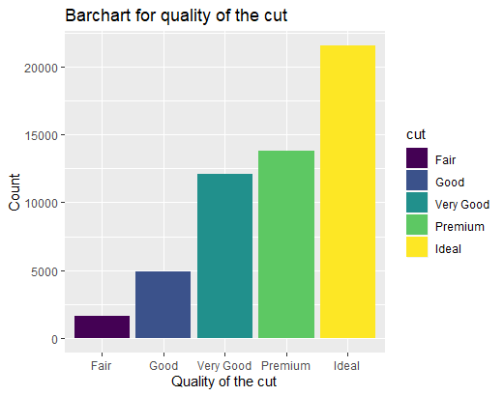
Interpret the key results for Bar chart
Differences in the heights of the bars.
ggplot(data = diamonds,aes(x = cut, fill =cut)) +
geom_bar() +
labs(title="Barchart for quality of the cut", x="Quality of the cut", y="Count")

Slide 10
Example- Bar chart
The bar chart shown in Fig. 1 represents the quality of the diamond cut. As can be seen in Fig. 1, there are five groups which are Fair, Good, Very Good, Premium, and Ideal. The most common value of the quality of the diamond cut is the Ideal cut with around 21,000 observations, while the least common value is the Fair cut with around 1600 observations. …..
Fig. 1. Bar chart for the quality of diamond cut.

Slide 11
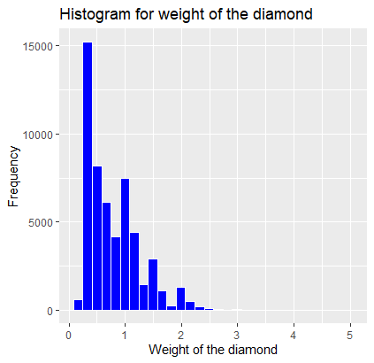
Interpret the key results for Histogram/Frequency Polygon
Peaks and spread
Symmetry of the data
Multiple modes
Outliers
ggplot(diamonds, aes(carat)) +
geom_histogram(col="white", fill="blue")+
labs(title="Histogram for weight of the diamond", x="Weight of the diamond", y="Frequency")

Slide 12
Example- Histogram
Fig.2 shows a histogram that represents the distribution of the diamond’s weight. As clearly shown in the figure, the distribution is right-skewed, and there is one peak when the weight of the diamond between 0.24879310 and 0.4146552 carats. The frequency of the peak is 15,200. There are few cases with a weight greater than 3 carats which are far away from other data values…..
Fig.2 The distribution of the diamond’s weight

Slide 13
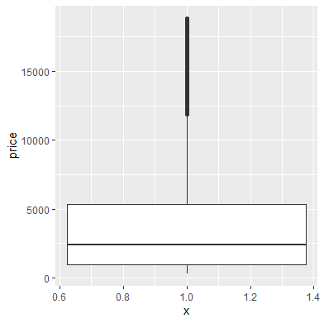
Interpret the key results for Boxplots
Centers and Spreads
Symmetry of the data
Outliers
ggplot(diamonds, aes(x = 1, y = price)) +
geom_boxplot()

Slide 14
2
Covariation

Slide 15
Covariation
Covariation is the tendency for the values of two or more variables to vary together in a related way.
The best way to spot covariation is to visualize the relationship between two or more variables.
Two continuous variables can be explored using scatter plots.
Two categorical variables can be explored by counting the number of observations for each combination.
A categorical and continuous variables can be explored using boxplots.

Slide 16
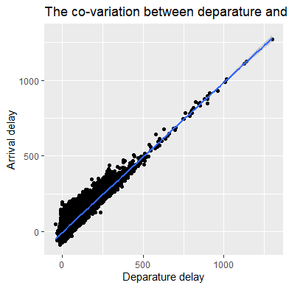
Interpret the key results for Scatterplot
Type of relationship.
Strength of relationship.
Outliers.
ggplot(flights, aes(x=dep_delay, y=arr_delay)) +
geom_point() +
geom_smooth()+
labs(title="The co-variation between deparature and arrival delay", x="Deparature delay", y="Arrival delay")

Slide 17
Example- Scatterplot
The scatter plot in Fig. 4 shows the co-variation between departure and arrival delay. As can be noticed in Fig. 4, there is a strong linear relationship between the two variables. A positive correlation can be seen between the variables in sense one variable increases while the other increases. It is good to note that there are few cases with a departure delay greater than 8 hours…….
Fig.4 The co-variation between departure and arrival delay.

Slide 18
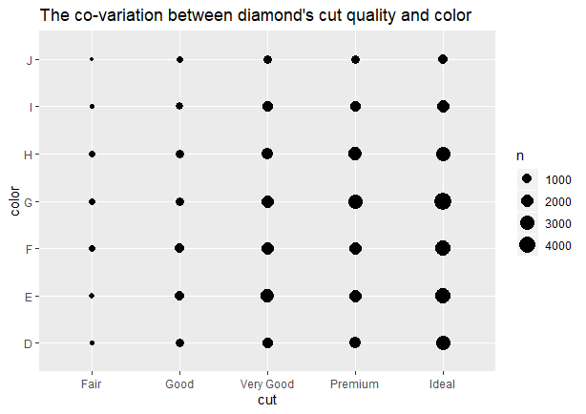
Interpret the key results for Count plot
N represents how many observations occurred at each combination of values. Covariation will appear as a strong correlation between specific x values and specific y values.
ggplot(diamonds, aes(x = cut, y = color)) +
geom_count() +
labs(title="The co-variation between diamond's cut quality and color", x="cut", y="color")

Slide 19
3
Data preprocessing- Working with missing and unusual values

Slide 20
Missing & Unusual Values
If there are unusual values in the dataset, then you have two options:
Drop the entire row with the strange values.
If one measurement in the row is invalid, doesn’t mean all the measurements are.
If you have low quality data and you’ve applied this approach to every variable, you might find that you don’t have any data left.
Replacing the unusual values with missing values.
A missing value occurs when no data value is found for a variable in an observation.

Slide 21
Missing & Unusual Values
Replacing NA with the mean value.
na.rm to indicate whether missing values should be stripped before the computation proceeds or not.
v <- c(1,2,3,4,NA,5,5,8,NA,NA)
avg = mean(v, na.rm = TRUE)
v_new <- ifelse(is.na(v), avg, v)
v_new
[1] 1 2 3 4 4 5 5 8 4 4

Slide 22
Quick Review

Slide 23
Learning outcomes
Summary of Main Teaching Points
Variation
Covariation
Unusual and missing values
You are able to use data visualization as a tool for data exploration to:
Study the variation of a variable.
Study the co-variation of two or more variables.
You are able to work with unusual and missing values.

Slide 24
Further reading materials:
https://r4ds.had.co.nz/exploratory-data-analysis.html
https://support.minitab.com/en-us/minitab-express/1/help-and-how-to/graphs/bar-chart/interpret-the-results/interpret-the-results/
https://support.minitab.com/en-us/minitab-express/1/help-and-how-to/graphs/histogram/interpret-the-results/key-results/
https://support.minitab.com/en-us/minitab-express/1/help-and-how-to/graphs/scatterplot/interpret-the-results/key-results/
https://www.youtube.com/watch?time_continue=203&v=PE_BpXTyKCE&feature=emb_logo
https://support.minitab.com/en-us/minitab-express/1/help-and-how-to/graphs/boxplot/interpret-the-results/key-results/

Slide 25
Question and Answer Session
Q & A
Book consultation slots for assistance.

Slide 26
Next Session
Data Manipulation
Tibbles
Pipes
dplyr package
filter function
arrange function
select function
mutate function
summarise function
group_by function
Using combination of these functions

